Slide 1
#Strategy Pattern
Intro
Hook
Explore
Explain
Apply
Share
Evaluate
Expand
Presenters:
Huỳnh Lê An Phú – 10421100
Phan Tâm Như - 10421122

Slide 2
#Table of Contents
Intro
Hook
Explore
Explain
Apply
Share
Evaluate
Expand
1. Overview
2. Implementation

Slide 3
Strategy Pattern
Intro
Hook
Explore
Explain
Apply
Share
Evaluate
Expand
Definition
The Strategy Pattern defines a family of algorithms, encapsulates each one, and makes them interchangeable.
Strategy Pattern is a behavioral pattern.

Slide 4
Strategy Pattern
Intro
Hook
Explore
Explain
Apply
Share
Evaluate
Expand
When to use
When having a lot similar classes that only differ in the way the execute some behaviors.
When having multiple algorithm for a specific task and be able to switch from an algorithm to another at runtime.

Slide 5
Strategy Pattern
Intro
Hook
Explore
Explain
Apply
Share
Evaluate
Expand
Pros and Cons
Can swap algorithms used inside an object at runtime.
Can isolate the implementation of an algorithm from the code that uses it.
Have to distinguish the differences between strategies to select a proper one.

Slide 6
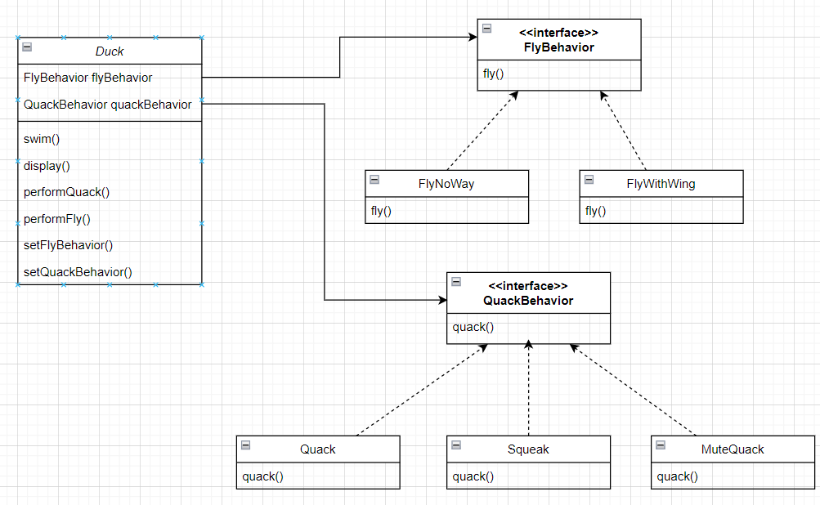
Intro
Hook
Explore
Explain
Apply
Share
Evaluate
Expand
Class Diagram

Slide 7
Description
Intro
Hook
Explore
Explain
Apply
Share
Evaluate
Expand
Create an application that can add, modify behaviors and execute functions accordingly.

Slide 8
Implementation
Intro
Hook
Explore
Explain
Apply
Share
Evaluate
Expand

Slide 9
#Thanks!

